Slide 1
DSI Project 1
Analysis on SAT & ACT for 2017 & 2018
Shaun Kwek

Slide 2
Problem Statement:
Is the funding/ financial support provided by the government body, justified with the participation rates for ACT/SAT gathered in the data?
Data Science Problem:
What is the trends in the increase/decrease in participation rate in SAT/ACT in 2017 and 2018'

Slide 3
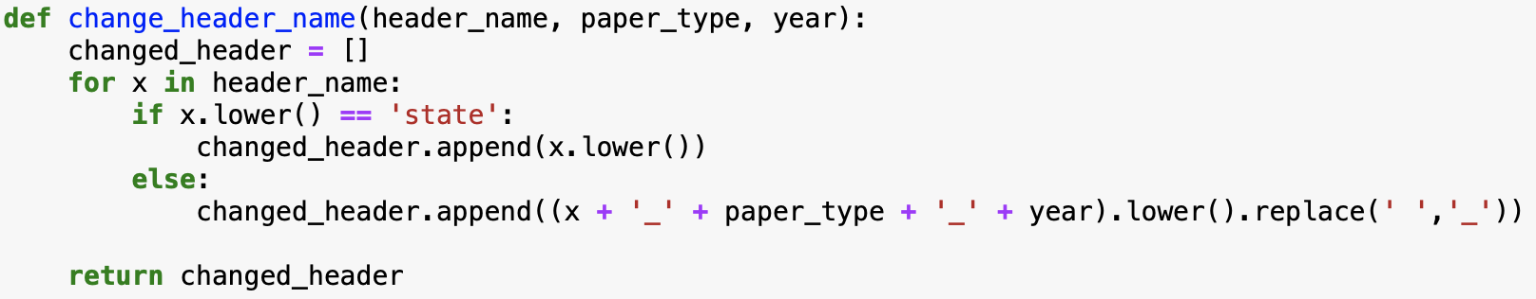
Data Cleaning
1) Understanding the headers of the given data 2) Checking for null values 3) Checking for values that are out of range 4) Cross checking with updated sources for correction 5) Checking appropriate datatype(s) of respective columns 6) Re-naming headers names 7) Making Data Dictionary 8) Dropping unnecessary Datas

Slide 4
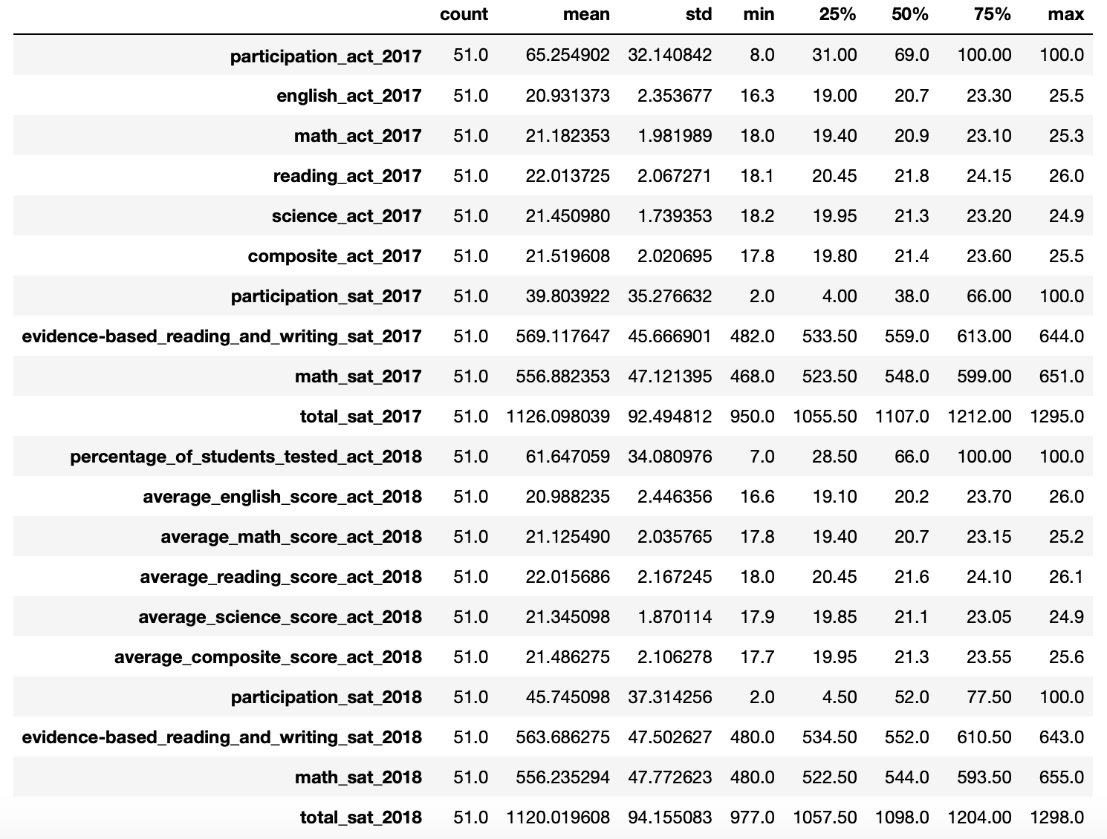
EDA - Summary Statistics

Slide 5
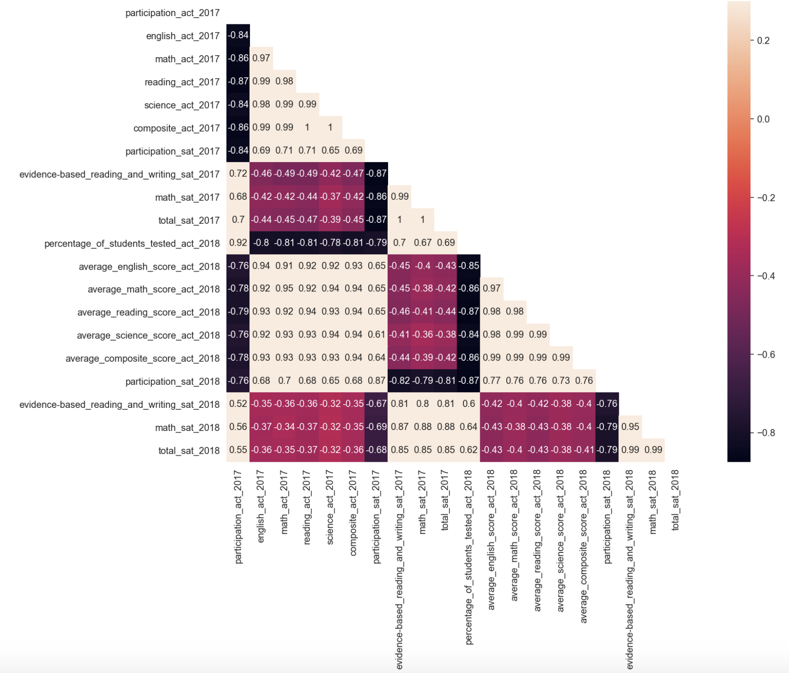
EDA - Trends

Slide 6
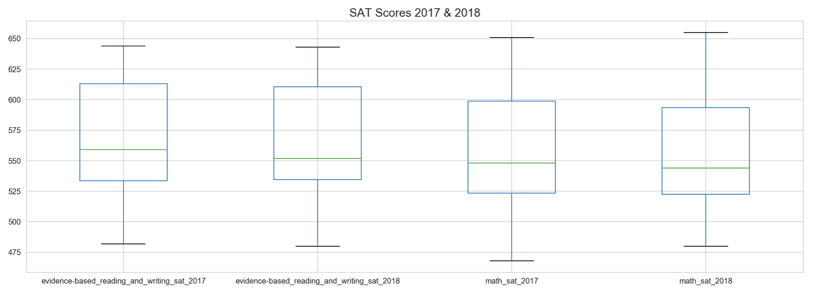
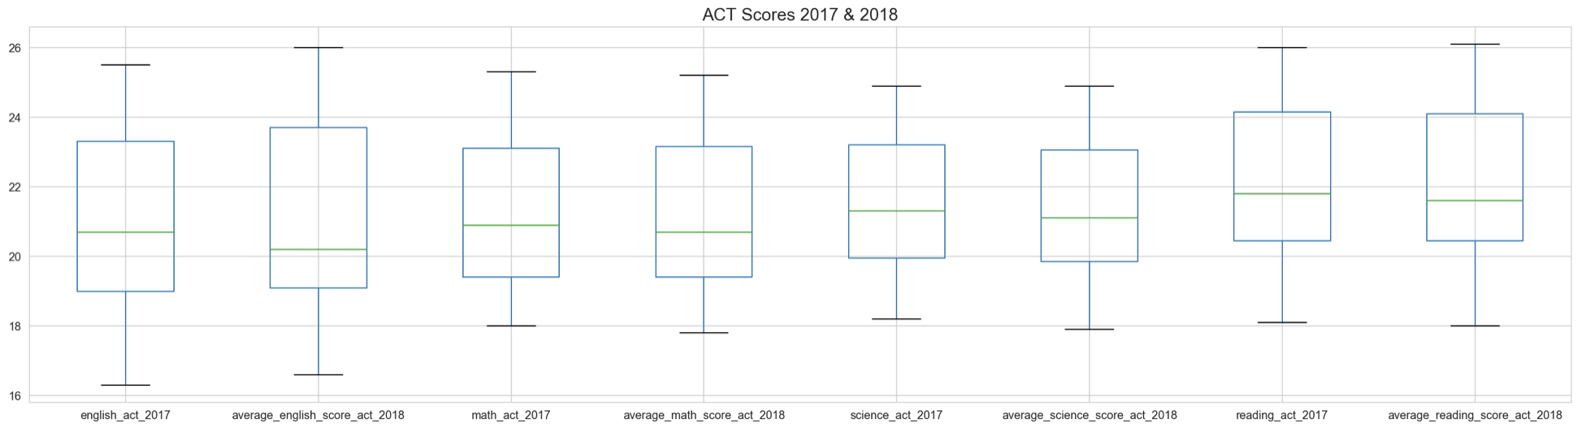
EDA - Box Plots

Slide 7
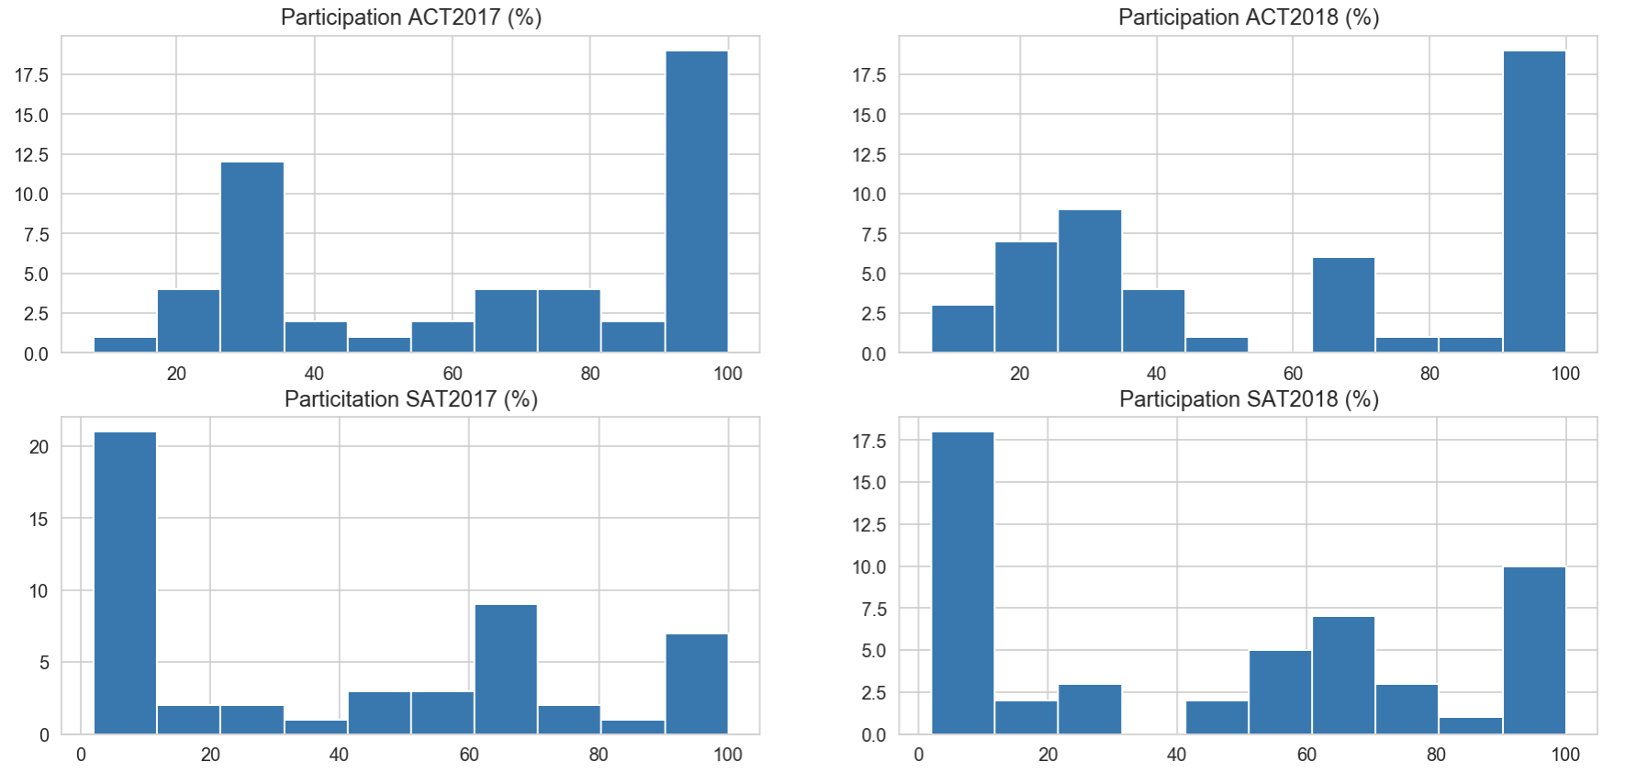
EDA - Histograms

Slide 8
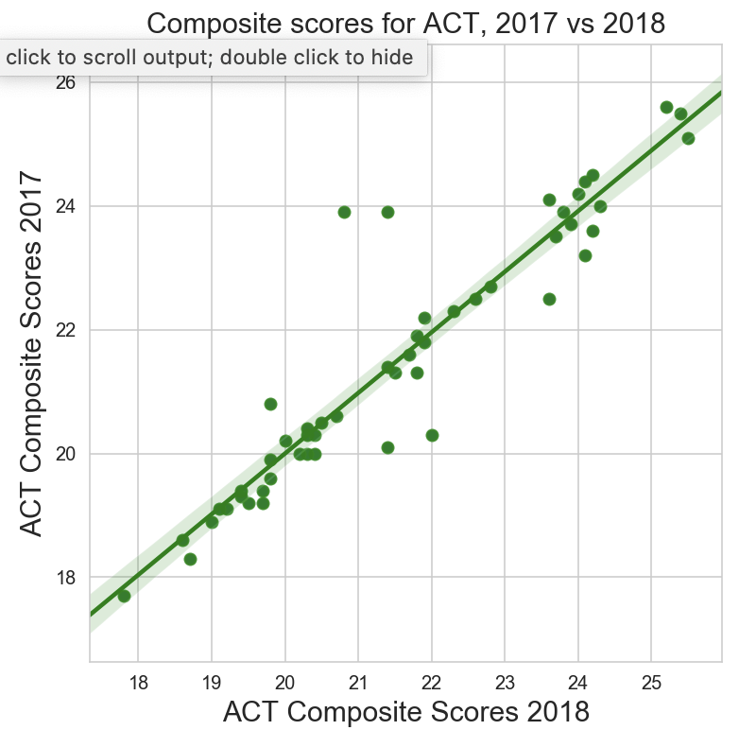
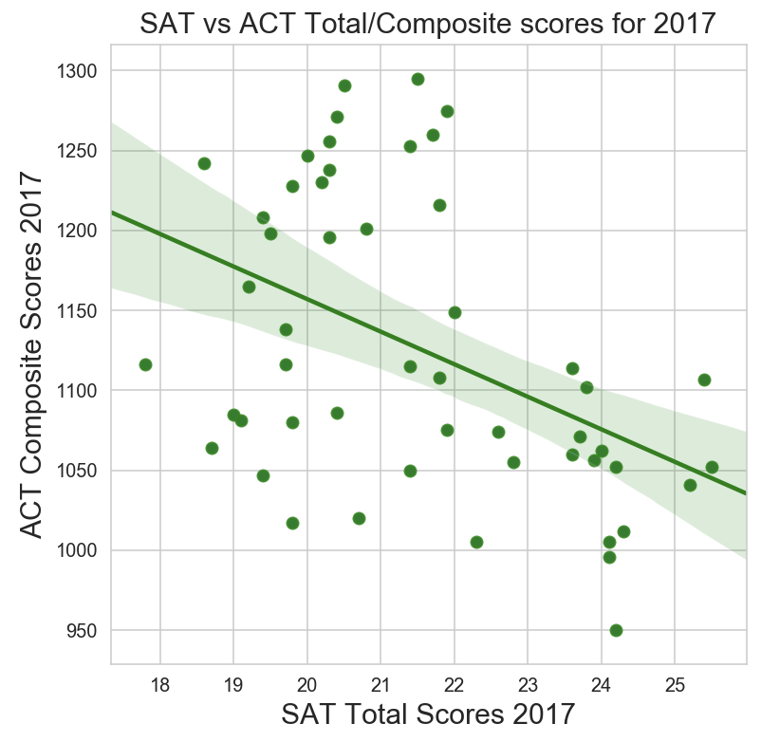
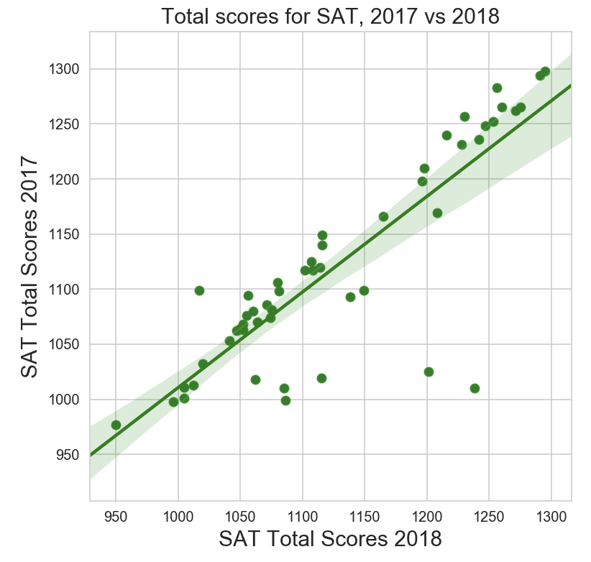
EDA - Scatterplots

Slide 9
Primary Findings
There is an inverse relationship of the ACT and SCT Total/Composite Scores.
There is an increase in Participation of SAT in 2018 when compared with 2017.
For ACT, Reading Scores are distinctively higher than the other 3 subjects.
For SAT, mean scores are around the same for both of the tested subjects

Slide 10
Analysis
Interested in finding the trend in participation of SAT and ACT exams:
Did 2 paired t-tests on 2 separate years:

Slide 11
Hypothesis testing
For 2017:
Null Hypothesis: There is no difference between the participation rate in SAT 2017 and ACT 2017 Mean(SAT17) == Mean(ACT17)
Alt. Hypothesis: There is a difference between the participation rate in SAT 2017 and ACT 2017 Mean(SAT17) != Mean(ACT17)

Slide 12
Hypothesis testing
For 2018:
Null Hypothesis: There is no difference between the participation rate in SAT 2018 and ACT 2018 Mean(SAT18) == Mean(ACT18)
Alt. Hypothesis: There is a difference between the participation rate in SAT 2018 and ACT 2018 Mean(SAT18) != Mean(ACT18)

Slide 13
Hypothesis testing
Alpha is set at 0.05
P-value for 2017 paired t-test = 0.00024 Since P-value < Alpha, There is a significance difference between the participation rate of SAT 2017 & ACT 2017
P-value for 2018 paired t-test = 0.02684 Since P-value < Alpha, There is a significance difference between the participation rate of SAT 2018 & ACT 2018

Slide 14
Where is this difference?
Post-Hoc test needed to see where this difference is leaning towards to. Is the difference towards having more participation in SAT or in ACT?

Slide 15
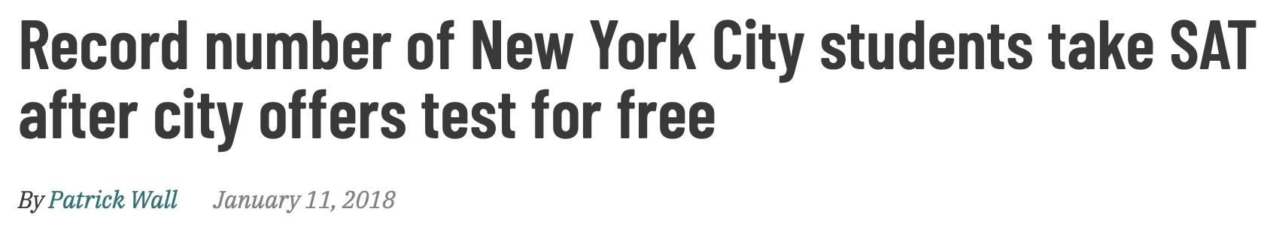


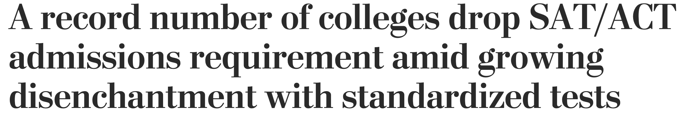
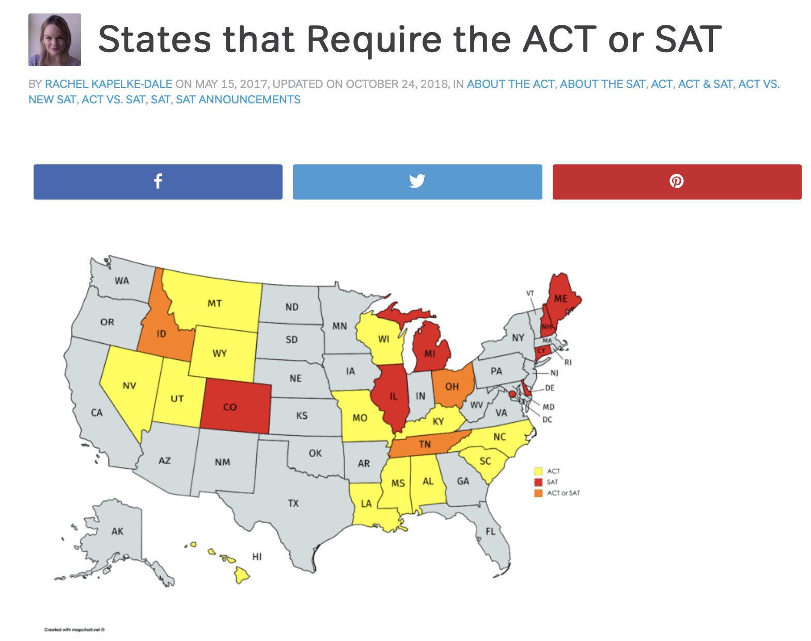
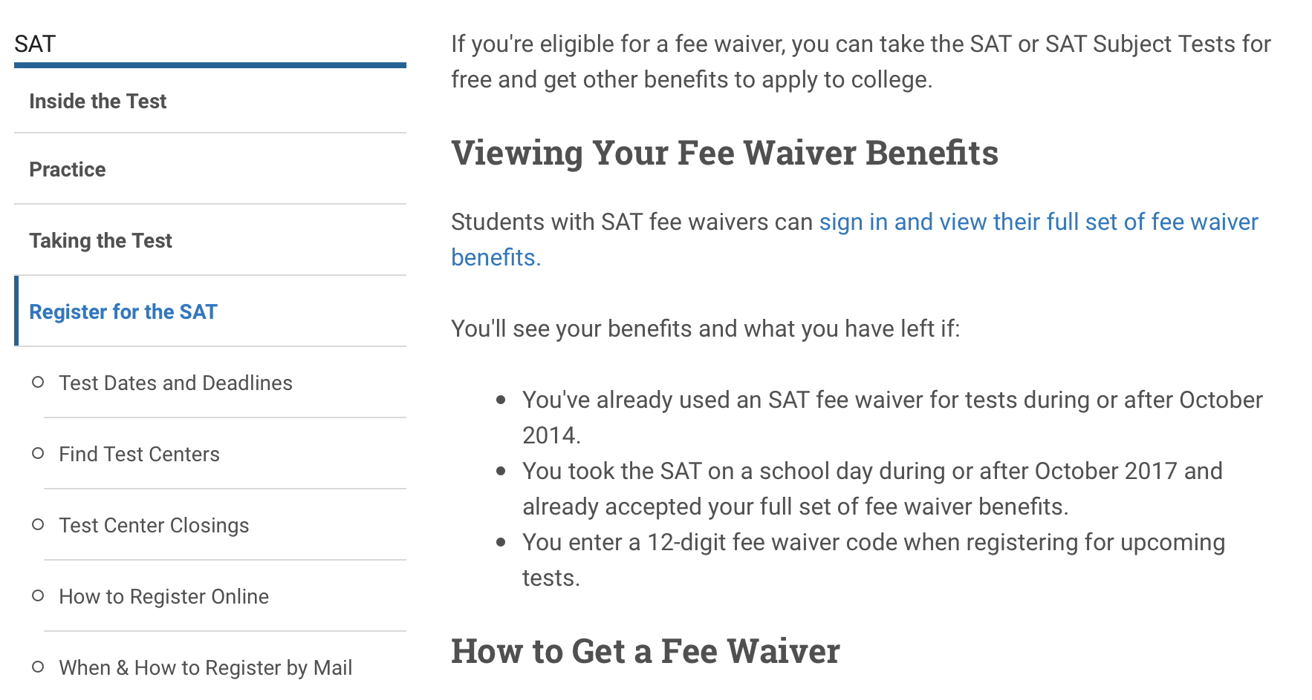
External Research

Slide 16
Recommendations
Provide more free waiver for SAT participation

Slide 17
References
Min/Max SAT Scores: https://blog.prepscholar.com/sat-score-range
Min/Max ACT Scores: https://blog.prepscholar.com/whats-the-highest-possible-act-score
College prefer SAT than ACT: https://www.collegeraptor.com/getting-in/articles/act-sat/act-vs-sat-which-college-entrance-exam-is-more-popular/
New York Takes SAT for free: https://chalkbeat.org/posts/ny/2018/01/11/record-number-of-new-york-city-students-take-sat-after-city-offers-test-for-free/
Colorado shift to take SAT: https://www.chalkbeat.org/posts/co/2015/12/23/goodbye-act-hello-sat-a-significant-change-for-colorado-high-schoolers/
Colleges dropping sat/act admission requirements https://www.washingtonpost.com/education/2019/10/18/record-number-colleges-drop-satact-admissions-requirement-amid-growing-disenchantment-with-standardized-tests/
States Requirements for ACT/SAT https://magoosh.com/hs/act/2017/states-that-require-the-act-or-sat/

